Slide 1
BIKE CRASH DETECTION
PIP104 PROFESSIONAL PRACTICE-II
VIVA-VOCE
Batch Number: CST16
Roll Number | Student Name
20201CST0149 | N. Likhith Raj
20201CST0105 | BANDI HEMANTH
20201CST0104 | V. AJAY BHARGAV
20201CST0134 | B. JAYADEEP REDDY
20201CST0101 | K. SIVA MALLESHWAR REDDY
Under the Supervision of,
Ms. Ankita Bhaurmik
School of Computer Science Engineering & Information Science
Presidency University

Slide 2
Introduction
A bike crash detection project uses sensors and technology to quickly detect and respond to bicycle accidents. Its goals are to enhance cyclist safety, reduce emergency response times, provide peace of mind, and collect valuable data on crash patterns and locations.A bike crash detection project uses sensors and technology to quickly detect and respond to bicycle accidents. Its goals are to enhance cyclist safety, reduce emergency response times, provide peace of mind, and collect valuable data on crash patterns and locations.
The rapid growth of technology has made our easier this advancement in technology also increased traffic hazarded. Hence ratio of road accident increases. Most of the Time loss of life due to poor emergency facilities. Our research provide a solution for accident detection and preventation of human life safety.

Slide 3
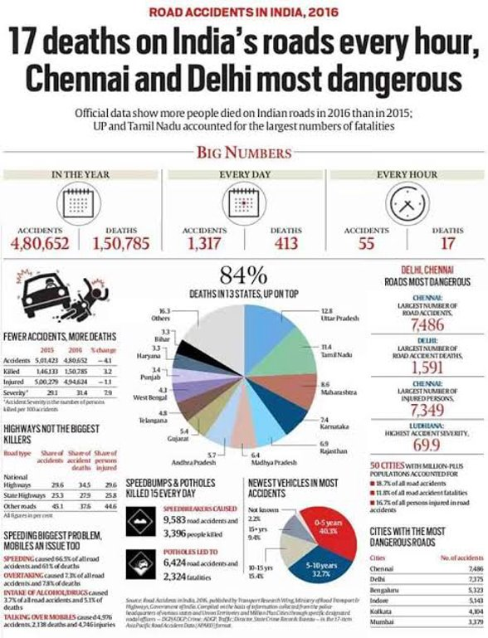
Introduction

Slide 4
Literature Review
TITLE | AUTHORS | PULICATION | LINK | SUMMARY
1.Accident Detection System with GPS, GSM, and Buzzer | Muhammad Ahmad Baballe , Naja'Atu Kabir Mustapha | ResearchGate | https://www.researchgate.net/publication/368646964_Accident_Detection_System_with_GPS_GSM_and_Buzzer | It introduces a system designed to enhance emergency response by promptly detecting and alerting authorities about accidents, focusing not only on passenger safety but also on immediate help after an accident.
2.Car crash detection using ensemble deep learning and multimodal data from dashboard cameras | Jae Gyeong Choi , Chan Woo Kong , Gyeongho Kim ,Sunghoon Lim | ScienceDirect | https://www.sciencedirect.com/science/article/pii/S095741742100823X | This paper discusses the serious consequences of motor vehicle accidents and explores two major technical solutions

Slide 5
Literature Review
TITLE | AUTHORS | PULICATION | LINK | SUMMARY
3.VEHICLE ACCIDENT DETECTION SYSTEM BY USING GSM AND GPS | MISS. YOJNA LONDHE • MISS. KAJAL LONDHE • MISS. TEJASWINI MOHITE | Journal of Emerging Technologies and Innovative Research | http://www.jetir.org/papers/JETIR2106371.pdf | Aimed at addressing the rising rate of road accidents and the lack of efficient emergency facilities, this solution leverages technology to enhance safety and provide timely assistance.
4.Automatic Vehicle Accident Detection and Messageing System | S. Parameswaran, P. Anusuya, M. Dhivya, A. Harshiya Banu, D. Naveen Kumar | NTERNATIONAL JOURNAL OF ENGINEERING RESEARCH & TECHNOLOGY (IJERT) | https://www.ijert.org/research/automatic-vehicle-accident-detection-and-messageing-system-IJERTCONV4IS11034.pdf | Utilizing GSM modem, the system sends immediate alerts to predefined contacts, offering a crucial solution to minimize response time and potentially save lives in critical situations

Slide 6

Research Gaps Identified
Certainly, there are drawbacks to existing methods/products in the market.
No Proper Product for Crash Detection and SOS Alert to Dedicated Authority:
There is a noticeable absence of a comprehensive product that effectively combines crash detection with an SOS alert system directed to a dedicated authority. The lack of such integration hinders timely responses in critical situations.
SOS Button Without Crash Detection:
While SOS buttons provide a manual way for users to signal for help, they lack the ability to automatically detect and alert authorities in the event of a crash. This reliance on manual activation can be problematic in situations where the user is incapacitated or unable to press the button.
Ex: Handlebar Switch ON-Off-ON 12V DC Button Operate

Slide 7
Proposed Methodology
The vehicle tracking system works mainly by receiving messages from a mobile phone.
There is a message command by which we can track the vehicle. And this command is to send an SMS; “TRACK VEHICLE” to the registered SIM card number in the GSM modem.
This command initiates the GPS modem and receives the latitude and longitude position and this information will then be sent as SMS to the mobile device.
Whenever theft occurs or on demand request of the vehicles location, the device sends a message to the vehicle owner’s mobile device

Slide 8
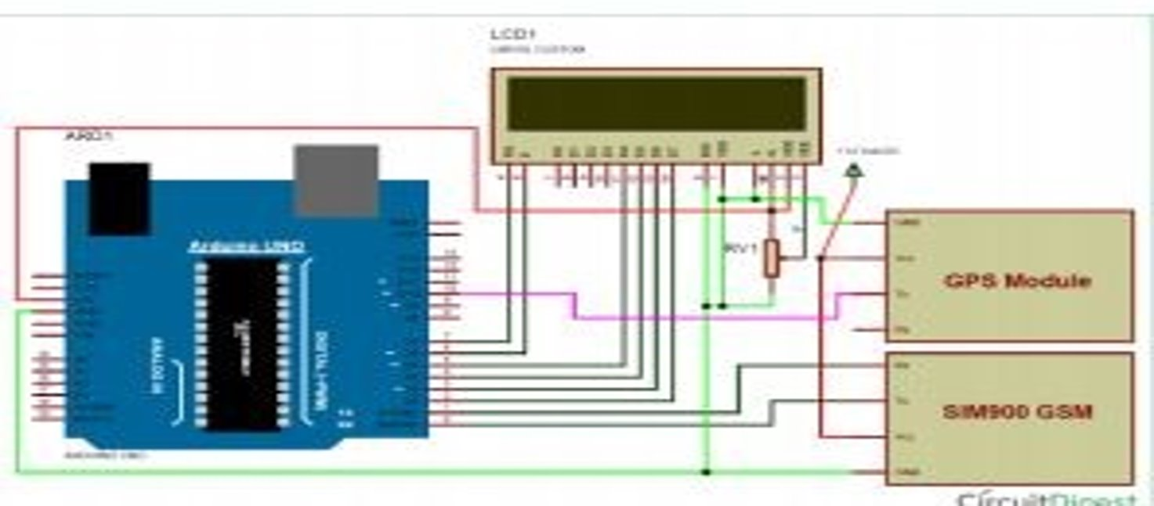
Proposed Methodology

Slide 9
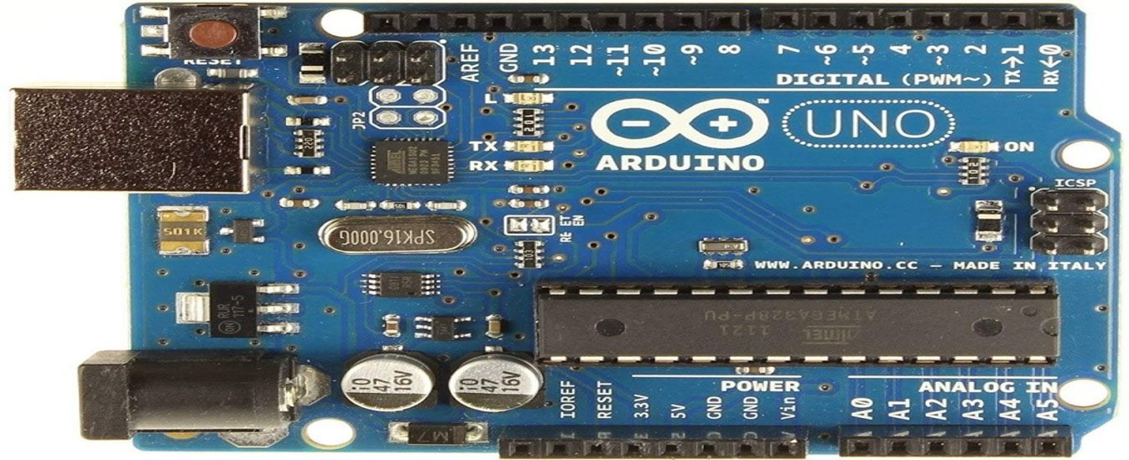
HARDWARE DETAILS
1:Arduino UNO

Slide 10
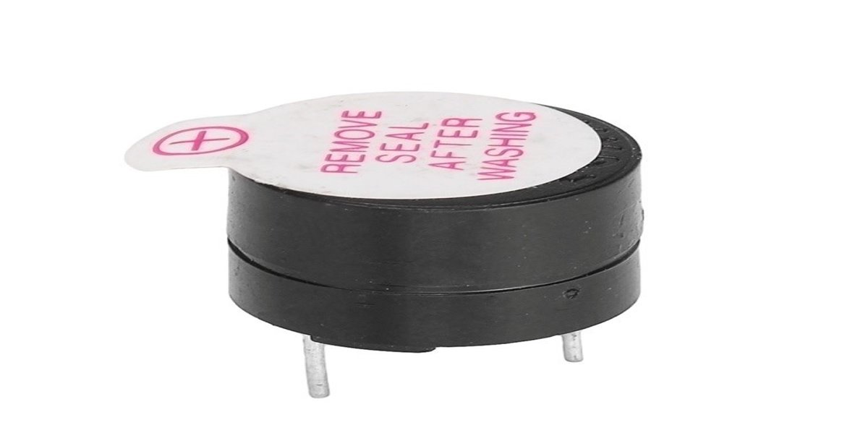
HARDWARE DETAILS
2:BUZZER

Slide 11
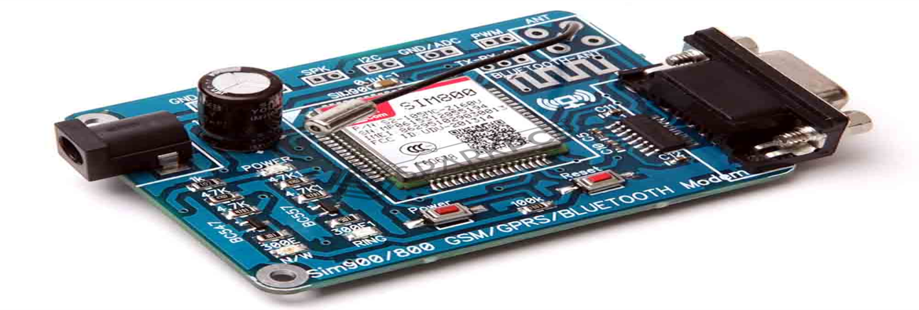
HARDWARE DETAILS
3:GSM MODULE

Slide 12
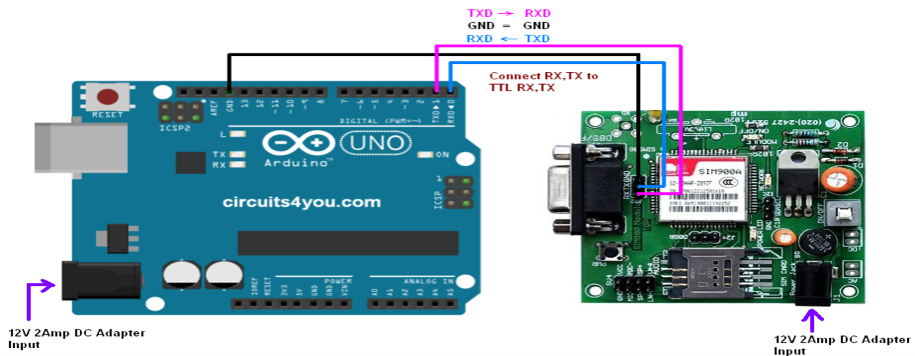
HARDWARE DETAILS
Interfacing GSM with Arduino UNO:

Slide 13
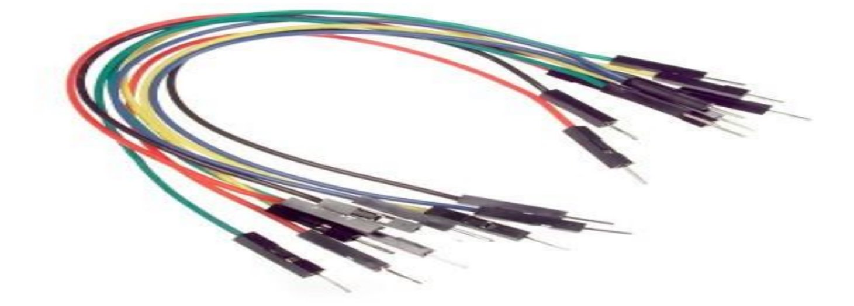
HARDWARE DETAILS
4:JUMP WIRES

Slide 14
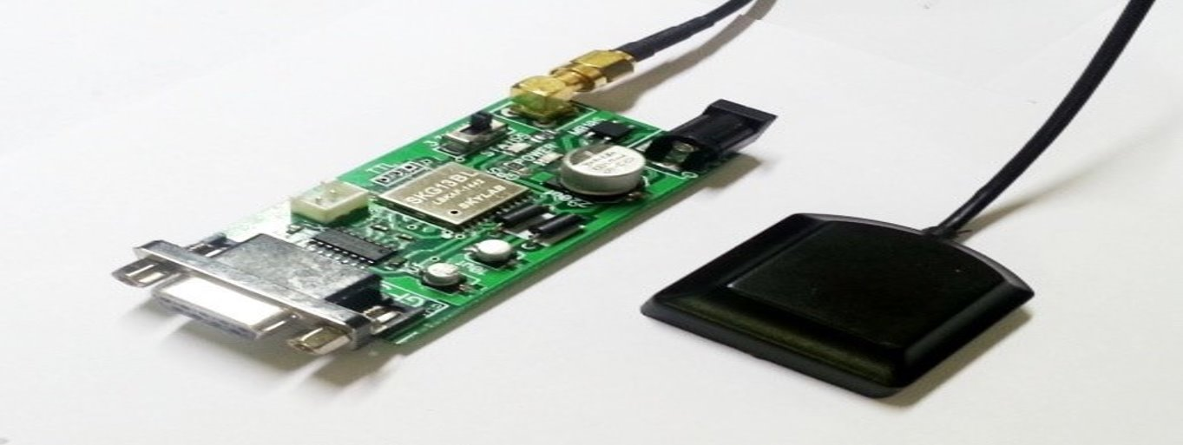
HARDWARE DETAILS
5:GPS MODULE

Slide 15
SOFTWARE DETAILS
Embedded C
Embedded C is a set of language extensions for the C programming language by the C Standards Committee to address commonality issues that exist between C extensions for different embedded systems
2.Arduino IDE(Compiler):
Arduino is an open-source electronics platform based on easy-to-use hardware and software. Arduino boards are able to read inputs - light on a sensor, a finger on a button, or a Twitter message - and turn it into an output - activating a motor, turning on an LED, publishing something online. You can tell your board what to do by sending a set of instructions to the microcontroller on the board. To do so you use the Arduino programming language (based on Wiring), and the Arduino Software (IDE), based on Processing.

Slide 16
Objectives
1: Develop a Crash Detection System
2: Minimize False Alarms
3: Establish Robust Communication
4: Ensure Compactibility
5: Prioritize User Safety
6: Cost-Effective Implementation
7: Establish a Scalable Infrastructure
8: Continuous Improvement and Innovation

Slide 17
System Design & Implementation
How It Works:
The accelerometer and gyroscope continuously monitor the bike's movements.
The Arduino processes sensor data using the crash detection algorithm to identify potential crashes.
If a crash is detected, the GSM module is triggered to send an SOS alert with location details via the communication interface.
The vehicle tracking system works mainly by receiving messages from a mobile phone.
There is a message command by which we can track the vehicle. And this command is to send an SMS; “TRACK VEHICLE” to the registered SIM card number in the GSM modem.
This command initiates the GPS modem and receives the latitude and longitude position and this information will then be sent as SMS to the mobile device.
Whenever theft occurs or on demand request of the vehicles location, the device sends a message to the vehicle owner’s mobile device
This modular architecture ensures a systematic and organized approach to building the bike crash detection and SOS alert system. Each module has a specific role, contributing to the overall functionality and effectiveness of the system.

Slide 18
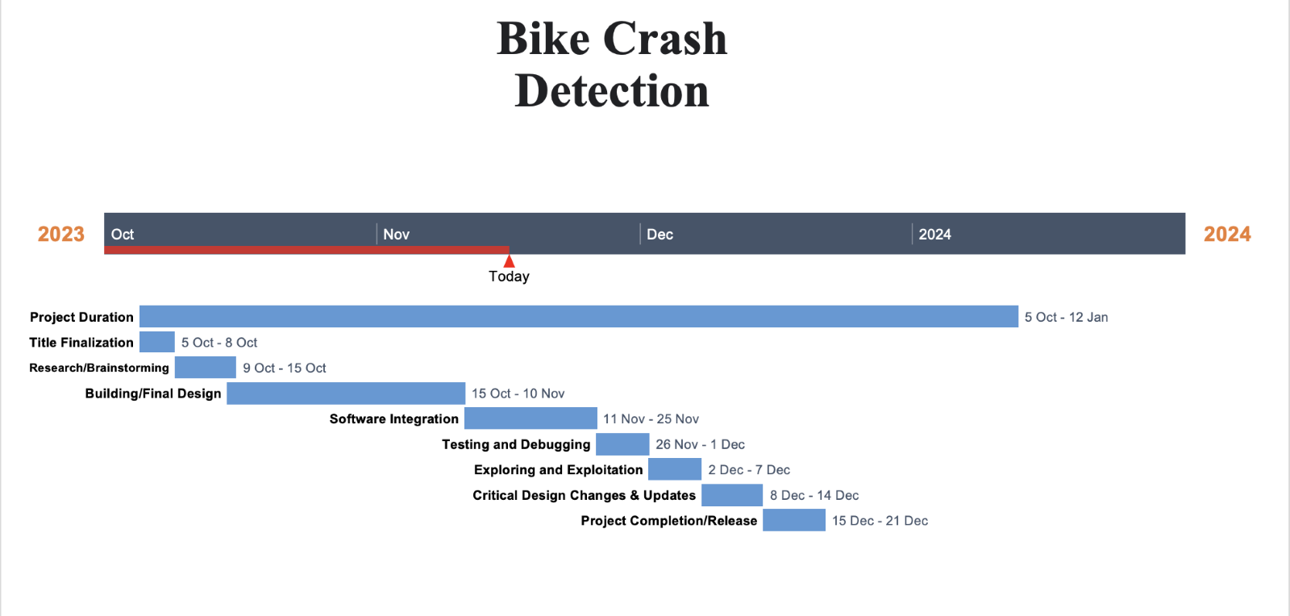
Timeline of Project

Slide 19
Outcomes / Results Obtained
Robust Bike Crash Detection:
Implementation of an advanced crash detection algorithm ensuring accurate identification of bike accidents based on sensor data.
Swift SOS Alert System:
Integration of a GSM module for rapid transmission of SOS alerts, including precise location details, to designated authorities or emergency contacts.
Real-time Response Capability:
Development of a system capable of providing immediate responses to bike crashes, reducing emergency response times and potentially minimizing the severity of injuries.
Enhanced User Safety:
Deployment of a user-friendly system that prioritizes the safety of bikers by providing timely alerts and assistance during critical situations.

Slide 20
Outcomes / Results Obtained
Scalability and Adaptability:
Design of a scalable system architecture, allowing for future enhancements and adaptability to different bike models or technological advancements.
Continuous Improvement Pathway:
Establishment of mechanisms for ongoing feedback collection and system updates, fostering continuous improvement based on user experiences and emerging technologies.
Contribution to Road Safety:
Overall, the expected outcomes aim to contribute significantly to road safety by providing a technologically advanced solution for preventing and mitigating the impact of bike accidents.

Slide 21
Conclusion
In summary, our Bike Crash Detection and SOS Alert System marks a significant step forward in improving road safety for two-wheeler users. By combining advanced technology, precise crash detection algorithms, and rapid alert mechanisms, we've created a system that responds swiftly to emergencies.
Our system prioritizes user safety with a user-friendly design and the potential for real-time awareness through a simple interface. Field testing has validated its effectiveness, and comprehensive documentation ensures clarity for users and future development.

Slide 22
References
[1] Bhuta, Desai,Keni “Alcohol Detection and Vehicle Controlling” International Journal of Engineering Trends and Applications (IJETA) – Volume 2 Issue 2, Mar-Apr 2015.
[2] Baburao Kodavati,V.K.Raju,S.Srinivasa Rao,A.V.Prabu T.Appa Rao, Dr.Y.V.Narayana, (2011) "GSM AND GPS BASED VEHICLE LOCATION AND TRACKING SYSTEM". International Journal of Engineering Research and Applications.Vol. 1, Issue 3
[3] M. Mubashir, L. Shao, and L. Seed “A survey on fall detection:Principlesand approaches,” Neurocomputing, vol. 100, no. 16, pp. 144–152, 2013.
[4] T. Shany, S. J. Redmond, M. R. Narayanan, and N. H. Lovell, “Sensors-Based wearable systems for monitoring of human movement and falls,”IEEE Sensors J., vol. 12, no. 3, pp. 658–670, Mar. 2012.
[5] B.Mirmahboub, S. Samavi,N.Karimi, and S. Shirani, “Automatic monocularsystem for human fall detection based on variations in silhouette area,”IEEE Trans. Biomed. Eng., vol. 60, no. 2, pp. 427–436, Feb. 2013.

Slide 23
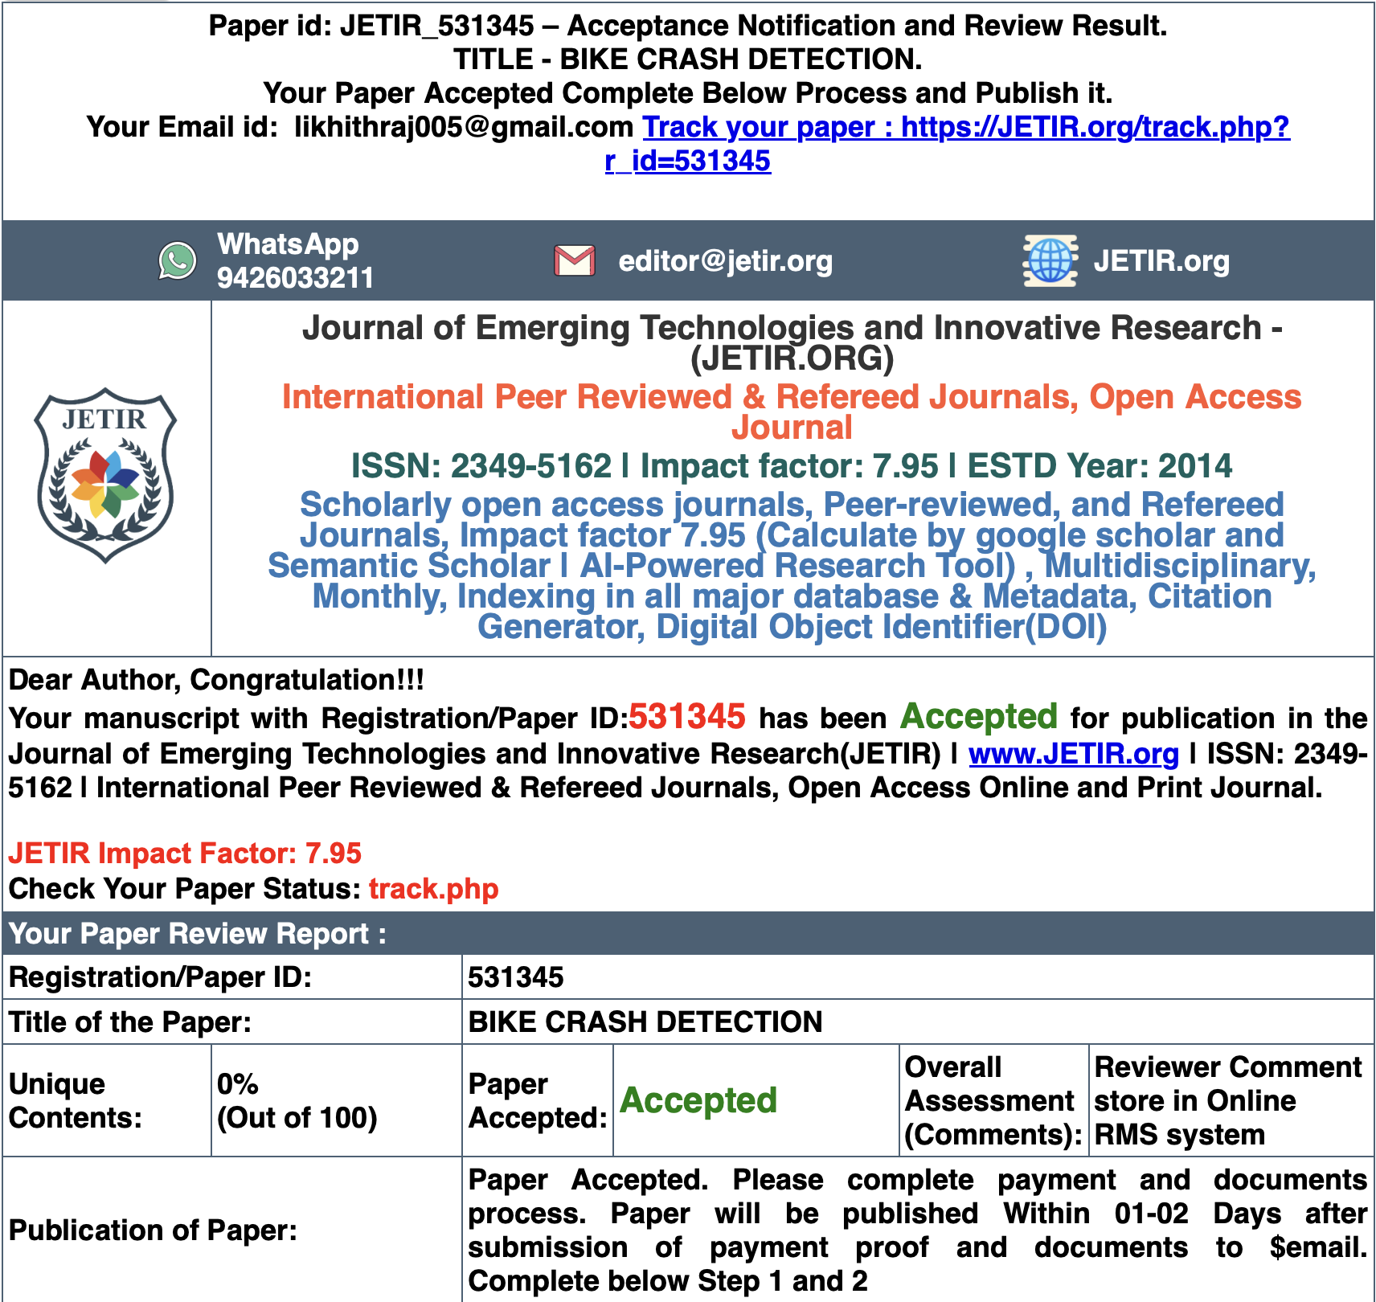
Publication Details

Slide 24

Thank You

